Slide 1
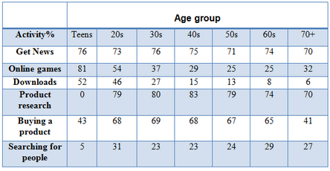
TABLE CHART

Slide 2
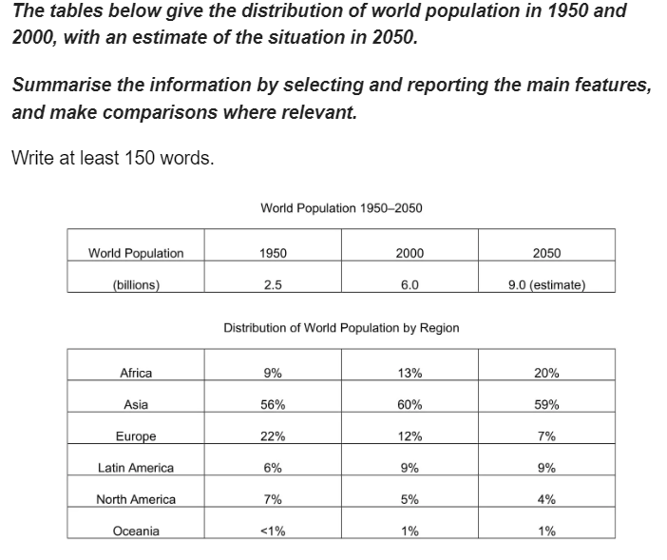

Slide 3
SAMPLE ANSWER
The table compares changes in worldwide population distribution between the six key regions from 1950 to 2000, with predictions for the year 2050. The only region where the percentage contribution is expected to increase by 2050 is Africa, while Europe is expected to have the greatest drop in proportion over the same time span. The sole continent showing a fluctuation in percentage contribution over the hundred year period is Asia.
From a relatively small percentage contribution of 9% in 1950, the people of Africa are forecast to make up a fifth of the total world population by 2050. This is almost a reversal of the situation for Europe which stood at 22% in 1950 and is expected to continue its steady decline to reach just 7% in 2050.
Another notable trend can be seen in the data for Asia which is the only region to show an increase in proportion contribution over the first fifty years but the prediction of a decline, albeit small, looking forward to 2050. The remaining regions, North America, Latin America and Oceania each make up less than 10% of the total world population and show only minor fluctuations in contribution over the whole time period.
(200 words)

Slide 4
BREAKDOWN AND EXPLANATION

Slide 5
Identify the Main Features
World Population 1950-2050
World Population | 1950 | 2000 | 2050
(Billions) | 2.5 | 6.0 | 9.0 (Estimate)
Distribution of World Population by Region
What are the units of measurements?
What are the time periods?
What can you learn from the title and any labels?
What is the most obvious trend?
Are there any notable similarities?
Africa | 9% | 13% | 20%
Asia | 56% | 60% | 59%
Europe | 22% | 12% | 7%
Latin America | 6% | 9% | 9%
North America | 7% | 5% | 4%
Oceania | <1% | 1% | 1%

Slide 6
Identify the Main Features
The key to understanding it is to use the clues given in the title, the row and column headings and the units of measurement.
For example, the title of the table tells us that it shows changes in world population from 1950 to projected levels in 2050.
The world is divided into regions (Africa, Asia, etc.) and data is given for three specific years – 1950, 2000 and projected data for 2050. This is a clue that we will need to use past, present and futures tenses in our essay.
In the first table, the units of measurement are billions of people and in the second table, percentages of the total world population are used.
Don’t look at the numbers in detail at this stage. Instead, focus on general trends. What are the most notable changes in data between 1950 and projected figures for 2050?

Slide 7
Identify the Main Features
World Population 1950-2050
World Population | 1950 | 2000 | 2050
(Billions) | 2.5 | 6.0 | 9.0 (Estimate)
Main feature 1: The only region where the percentage is expected to increase by 2050 is Africa.
Main feature 2: Europe is expected to have the greatest drop in percentage contribution by 2050.
Main feature 3: The only region showing a fluctuation in percentage contribution over the whole time period is Asia.
Distribution of World Population by Region
Africa | 9% | 13% | 20%
Asia | 56% | 60% | 59%
Europe | 22% | 12% | 7%
Latin America | 6% | 9% | 9%
North America | 7% | 5% | 4%
Oceania | <1% | 1% | 1%

Slide 8
Write an Introduction
Question:
The tables below give the distribution of world population in 1950 and 2000, with an estimate of the situation in 2050.
Introduction (Paragraph 1):
The table compares changes in worldwide population distribution between the six key regions from 1950 to 2000, with predictions for the year 2050.
DO NOT GIVE ANY HEADING
THE HEADINGS OF THE PARAGRAPHS ARE FOR EXPLANATION ONLY
YOUR WRITING SHOULD ONLY HAVE PARAGRAPHS AS SHOWN IN THE LAST SLIDE

Slide 9
Write an Overview
World Population 1950-2050
World Population | 1950 | 2000 | 2050
(Billions) | 2.5 | 6.0 | 9.0 (Estimate)
Main feature 1: The only region where the percentage is expected to increase by 2050 is Africa.
Main feature 2: Europe is expected to have the greatest drop in percentage contribution by 2050.
Main feature 3: The only region showing a fluctuation in percentage contribution over the whole time period is Asia.
Overview (Paragraph 1):
The only region where the percentage contribution is expected to increase by 2050 is Africa, while Europe is expected to have the greatest drop in proportion over the same time span. The sole continent showing a fluctuation in percentage contribution over the hundred year period is Asia.
Distribution of World Population by Region
Africa | 9% | 13% | 20%
Asia | 56% | 60% | 59%
Europe | 22% | 12% | 7%
Latin America | 6% | 9% | 9%
North America | 7% | 5% | 4%
Oceania | <1% | 1% | 1%
DO NOT GIVE ANY HEADING
THE HEADINGS OF THE PARAGRAPHS ARE FOR EXPLANATION ONLY
YOUR WRITING SHOULD ONLY HAVE PARAGRAPHS AS SHOWN IN THE LAST SLIDE

Slide 10
Write the 1st Detail Paragraph
World Population 1950-2050
Main feature 1: The only region where the percentage is expected to increase by 2050 is Africa.
Main feature 2: Europe is expected to have the greatest drop in percentage contribution by 2050.
Paragraph 2:
From a relatively small percentage contribution of 9% in 1950, the people of Africa are forecast to make up a fifth of the total world population by 2050. This is almost a reversal of the situation for Europe which stood at 22% in 1950 and is expected to continue its steady decline to reach just 7% in 2050.
World Population | 1950 | 2000 | 2050
(Billions) | 2.5 | 6.0 | 9.0 (Estimate)
Distribution of World Population by Region
Africa | 9% | 13% | 20%
Asia | 56% | 60% | 59%
Europe | 22% | 12% | 7%
Latin America | 6% | 9% | 9%
North America | 7% | 5% | 4%
Oceania | <1% | 1% | 1%
DO NOT GIVE ANY HEADING
THE HEADINGS OF THE PARAGRAPHS ARE FOR EXPLANATION ONLY
YOUR WRITING SHOULD ONLY HAVE PARAGRAPHS AS SHOWN IN THE LAST SLIDE

Slide 11
Write the 2nd Detail Paragraph
World Population 1950-2050
World Population | 1950 | 2000 | 2050
(Billions) | 2.5 | 6.0 | 9.0 (Estimate)
Main feature 3: The only region showing a fluctuation in percentage contribution over the whole time period is Asia.
Paragraph 3:
Another notable trend can be seen in the data for Asia which is the only region to show an increase in proportion contribution over the first fifty years but the prediction of a decline, albeit small, looking forward to 2050. The remaining regions, North America, Latin America and Oceania each make up less than 10% of the total world population and show only minor fluctuations in contribution over the whole time period.
Distribution of World Population by Region
Africa | 9% | 13% | 20%
Asia | 56% | 60% | 59%
Europe | 22% | 12% | 7%
Latin America | 6% | 9% | 9%
North America | 7% | 5% | 4%
Oceania | <1% | 1% | 1%
*albeit-though
DO NOT GIVE ANY HEADING
THE HEADINGS OF THE PARAGRAPHS ARE FOR EXPLANATION ONLY
YOUR WRITING SHOULD ONLY HAVE PARAGRAPHS AS SHOWN IN THE LAST SLIDE

Slide 12
SAMPLE ANSWER
The table compares changes in worldwide population distribution between the six key regions from 1950 to 2000, with predictions for the year 2050. The only region where the percentage contribution is expected to increase by 2050 is Africa, while Europe is expected to have the greatest drop in proportion over the same time span. The sole continent showing a fluctuation in percentage contribution over the hundred year period is Asia.
From a relatively small percentage contribution of 9% in 1950, the people of Africa are forecast to make up a fifth of the total world population by 2050. This is almost a reversal of the situation for Europe which stood at 22% in 1950 and is expected to continue its steady decline to reach just 7% in 2050.
Another notable trend can be seen in the data for Asia which is the only region to show an increase in proportion contribution over the first fifty years but the prediction of a decline, albeit small, looking forward to 2050. The remaining regions, North America, Latin America and Oceania each make up less than 10% of the total world population and show only minor fluctuations in contribution over the whole time period.
(200 words)

